Slide 1
Predicting Altruism Through Free Pizza
Project 4 - NLP
Rudy Wang

Slide 2
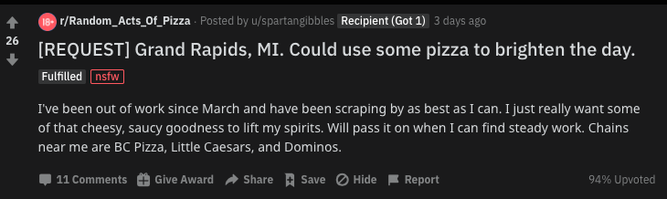
Random Acts of Pizza
115k members (as of August 2020)
Not very active Subreddit, strict rules for members who want to request pizza.
Moderators and bots that keep track of pizza transactions.

Slide 3

Better Ingredients, Better Pizza
 | Total
Total Submissions | 38,647
Training Dataset | 30,420
Testing Dataset | 8,227
Random Acts of Pizza Submissions (Kaggle)
A subreddit on Reddit.com that allows users to submit posts requesting free pizza from other users of the site.
5,671 total requests between December 8, 2010 and September 29, 2013.
PRAW (Python Reddit API Wrapper) and Pushshift API
Pushshift API – serves as a copy of Reddit objects (extracted RAOP requests from January 1, 2014 – August 13, 2020).
PRAW – pulled updated “flair” information that identifies whether a request was fulfilled or not.
32,976 total requests between January 1, 2014 – August 13, 2020 (Kept only submissions that were tagged as either “fulfilled” or had no flair (was not fulfilled).

Slide 4

Crust the Process
MongoDB and PANDAs
Pre-Process (spaCy)
EDA – Feature Engineering
Sentiment Analysis (VADER)
Topic Modelling – TF-IDF & NMF
Trained Models
Output Test Data Accuracy

Slide 5
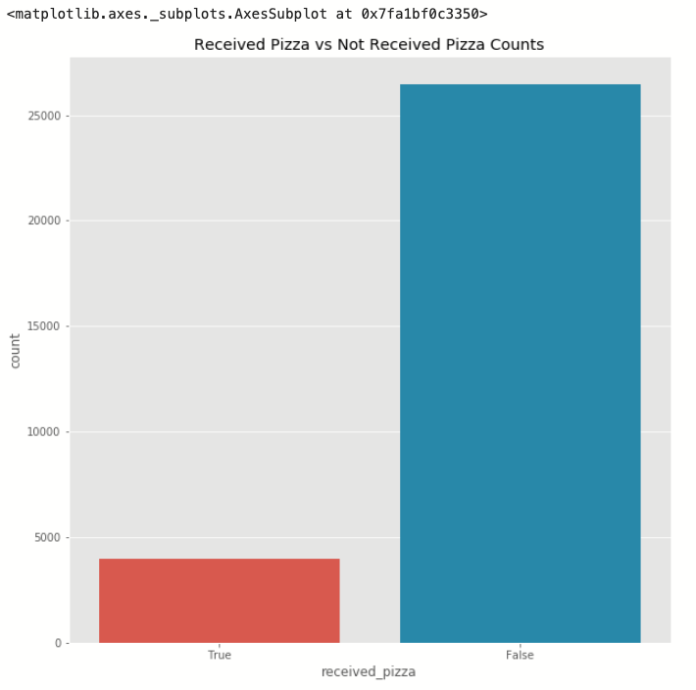


EDA – Received vs Not Received Counts.
There were only 3,927 submissions that received pizza.
There were about 26,493 submissions that did not receive pizza.

Slide 6
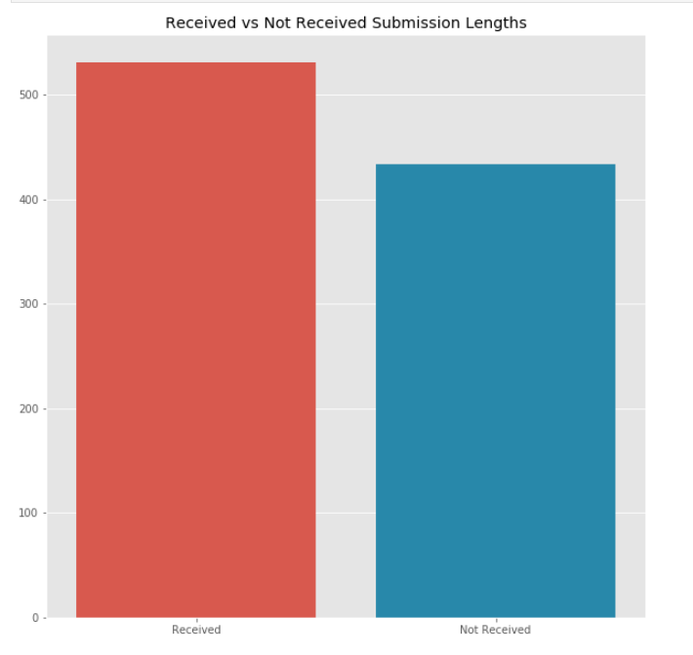
EDA – Character Length of Submissions
Received Pizza Submissions had an average of 530 characters.
Not Received Pizza Submissions had an average of 433 characters.
Added as an extra feature to assist with classification.

Slide 7
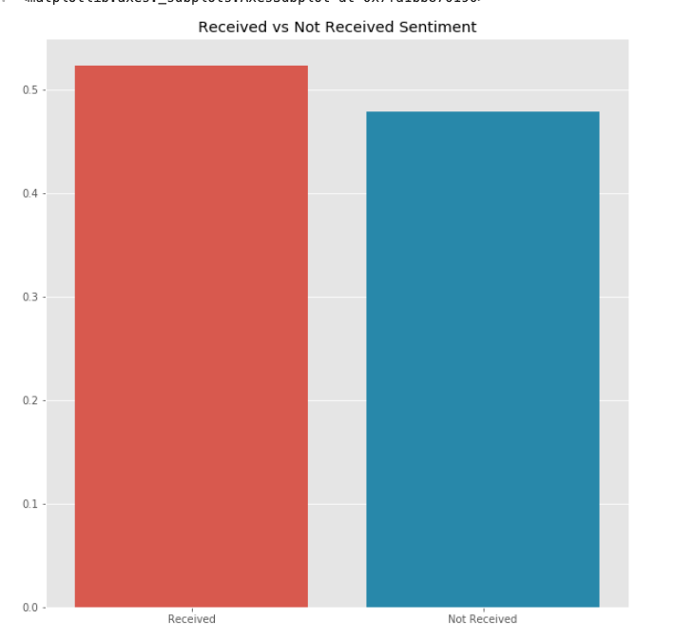
Sentiment Analysis - VADER
Received Pizza Submissions had an average sentiment score of .52.
Not Received Pizza Submissions had an average sentiment score of .48.
Added as an extra feature to assist with classification.

Slide 8






NMF Topic Modelling (TF-IDF) Received Not Received
Family: home, family, kid, wife, mom, husband…
Unemployment: job, paycheck, interview, unemployed, struggle…
Money: account, rent, check, broke, cash…
Student: student, college, ramen, school, semester…
Favors + Specials: celebrate, birthday, surprise, dinner, smile…
Family: home, family, kid, wife, mom, husband…
Unemployment: job, paycheck, interview, unemployed, struggle…
Money: account, rent, check, broke, cash…
Student: student, college, ramen, school, semester…
Homeless: hungry, broke, homeless, starve, pantry

Slide 9
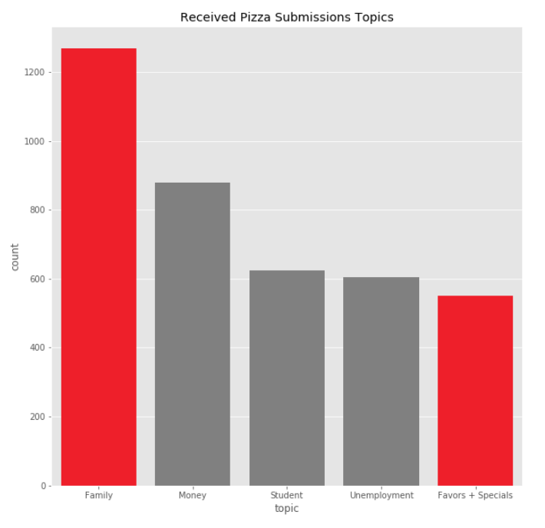
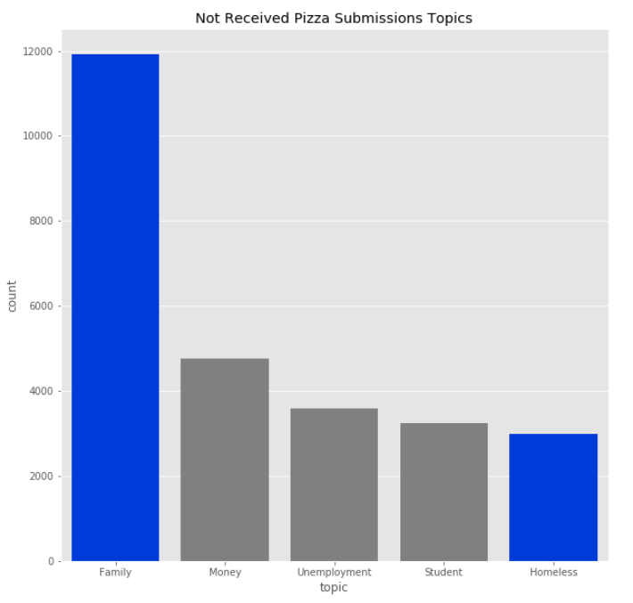
Received vs Not Received NMF Topic Modeling

Slide 10
NMF Topic Modelling (TF-IDF) on Training Data
Family: love, home, family, sick, kid, mom, wife, husband
Student: hungry, student, college, final, study, ramen, semester, university
Money: pay, bill, rent, paycheck, broke, cash, deposit, bank
Unemployment: job, lose, paycheck, check, unemployed, struggle, unemployment, save

Slide 11

Classification - Accuracy
Model | Accuracy Score
KNN – Training Score (CV = 10) | 0.85
KNN – Test Score (CV = 10) | 0.91

Slide 12

Conclusion
Higher Sentiment, Longer Character Submissions are found within submissions that received pizza.
Write using more positive language and don’t be shy with the length of your story!
If you’re homeless, it’s harder to get your request filled as the users need to communicate with the mods on the subreddit to verify receipts and payment (do not mention you are homeless, if you are indeed homeless).
Most submissions do not get pizza – and the topics for both received and not received submissions are very similar: free lunch is possible, but difficult!

Slide 13

Future Work
A Free Pizza for ALL.
User can input a story, will give direct feedback whether the story will garner a free pizza or not.
Ethics? This cannot really be abused, due to high level of moderator screening on RAOP: Maximum two requests per month, and a history of your account can appear fishy if constantly posting.

Slide 14

Questions?

Slide 15

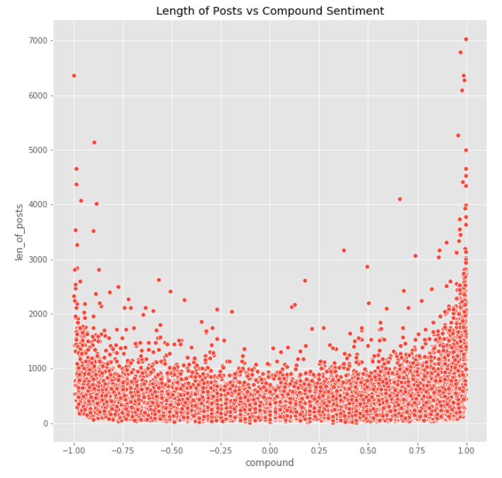
Appendix

